Slide 1

School of Computing Science and Engineering
School Of Computing Science And Engineering
B. Tech CSE
2023-24
Semester 7 (Fall-Batch)
Project V
Title: Face Recognition Attendence System Using Face Encoding Algorithm
Team Member’s Details BT4101
S. No. | Participant Name | Mobile NO. | Mail ID
1 | Manish Kumar | 7827043684 | sahmanish10987@gmail.com
2 | Yuvraj Singh | 9058826896 | yuvraj.20scse1010824@galgotiasuniversity.edu.in
Faculty (College) Mentor’s Details
S. No. | Mentor Name | Mobile NO. | Mail ID
1 | Mr. Ajay Shankar | 9557051717 | ajay.shankar@galgotiasuniversity.edu.in
Project V B. Tech CSE Sem 7

Slide 2
School of Computing Science and Engineering
1. Introduction
Problem
There is no reason that a critical educational practice like attendance should be viewed in the old, tedious manner in this age of rapidly evolving new technologies. In the conventional method, it is difficult to manage large groups of students in a classroom. Since it takes time and has a high risk of error when entering data into a system, it is not recommended. Real-Time Face Recognition is a practical method for dealing with a large number of students' attendance on a daily basis.
Advantages
Nullifies false participation
Saves time
Can be used for monitoring purpose also
Old method requires considerable amount of time
Old methods can't keep up with the increase in number of students, same can be said for the workplaces where employee count is in thousands.
Modern methods like RFID is no solution as its deployment is expensive and large scale is not efficient.
Coding of faces seems to be best practice and can be implemented from one clear image for further analysis.
Multidirectional recognition can boost its accuracy in detection, identification and analysis
Project V B. Tech CSE Sem 7

Slide 3
School of Computing Science and Engineering
2.1 Related Work
2.1 Student Attendance Monitoring System Using Face Recognition by E CHARAN SAI, SHAIK ALTHAF HUSSAIN, SYED KHAJA, AMARA SHYAM :: SSRN– They used Haar-cascade model to detect faces and passed the cropped images from frame for processing. This method boosts the performance by analyzing only those images which are in ROI(Region of Interest)
2.2 Automated Attendance System using Machine Learning Approach– In this paper Histogram of Oriented Gradient approach is used which boosted the processing speed and reduce the cpu throughput which is further assisted by changing images to greyscale and oriented gradient for reduced input data. This approach is by far the best method to increase speed but with the expanse of accuracy and augmentation in labeled images.
Project V B. Tech CSE Sem 7

Slide 4
School of Computing Science and Engineering
2.1 Related Work
2.3 Automated attendance system using face recognition A Jadhav, A Jadhav, T Ladhe… -RFID (Radio Frequency Identification)-based Attendance System A number of works related to Radio Frequency Identification (RFID) based Attendance Systems exist in the literature. In [6] the authors have proposed RFID based system in which students carry a RFID tag type ID card and they need to place that on the card reader to record their attendance. RS232 is used to connect the system to the computer and save the recorded attendance from the database. This system may give rise to the problem of fraudulent access. Unauthorized person may make use of authorized ID card and enter into the organization
Fingerprint based Attendance System In [1] A portable fingerprint device has been developed which can be passed among the students to place their finger on the sensor during the lecture time without the instructor’s intervention. This system guarantees a foolproof method for marking the attendance. The problem with this approach is that passing of the device during the lecture time may distract the attention of the students.
Project V B. Tech CSE Sem 7

Slide 5
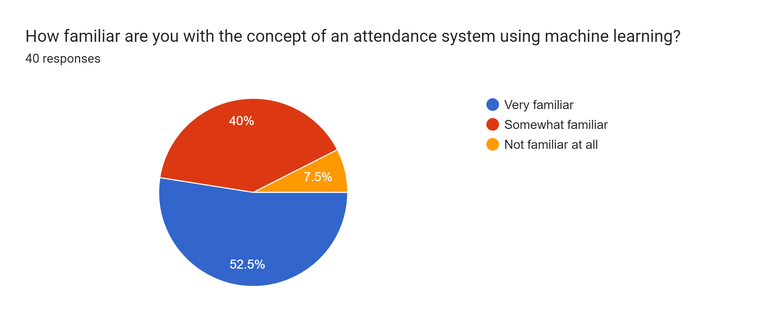
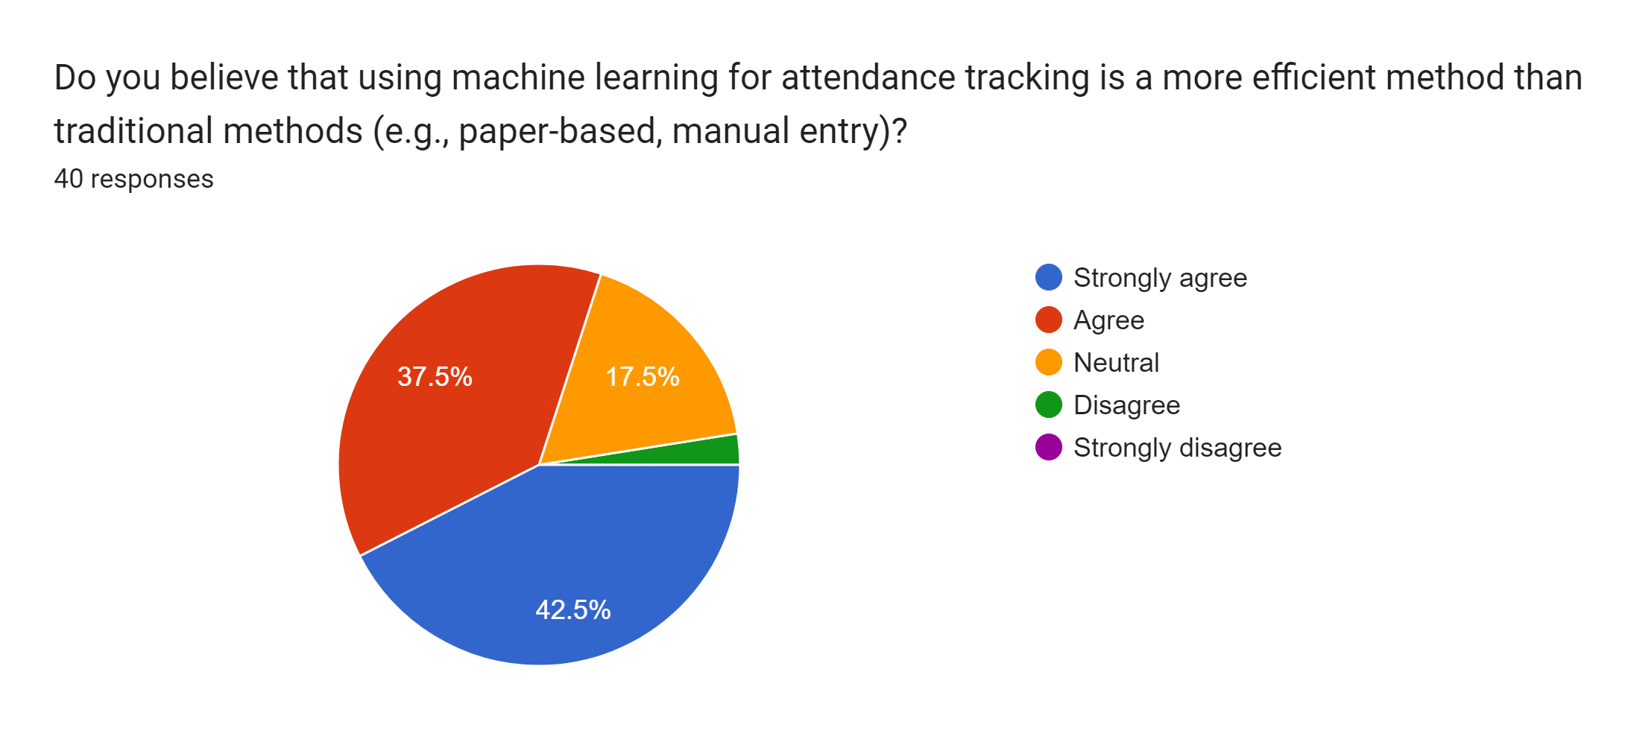
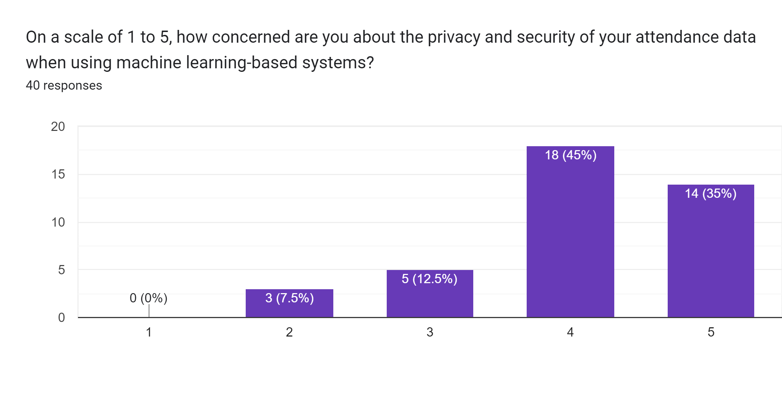
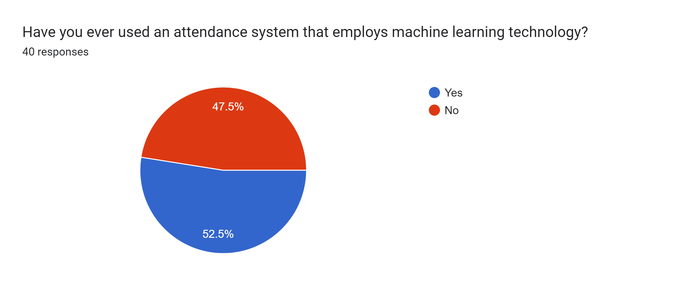
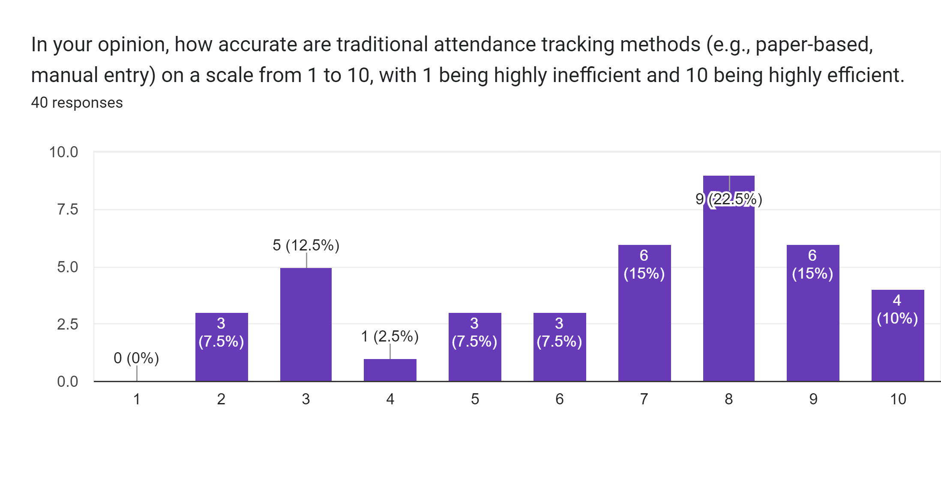
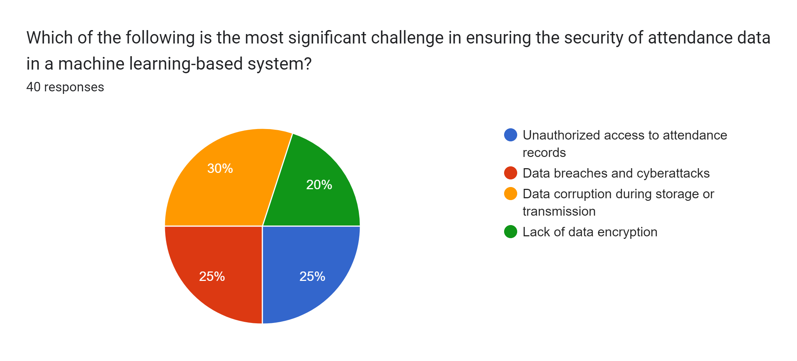
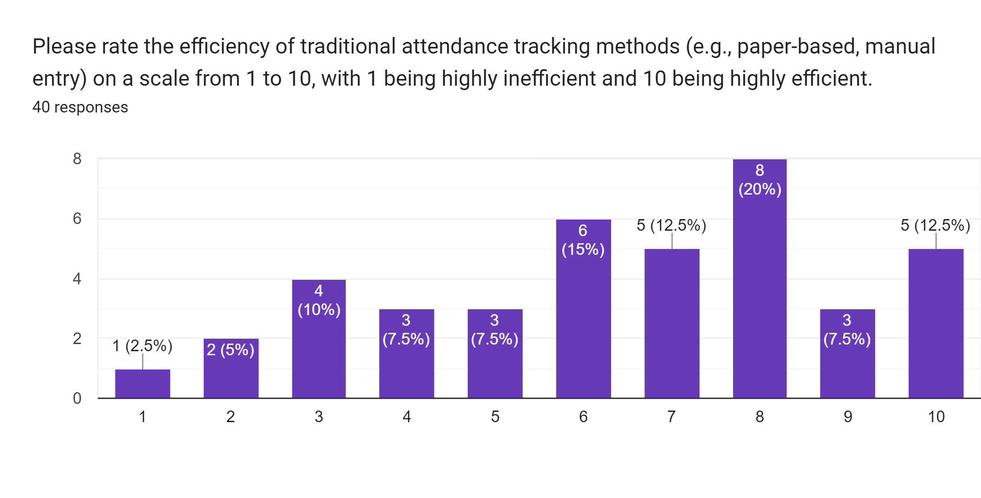
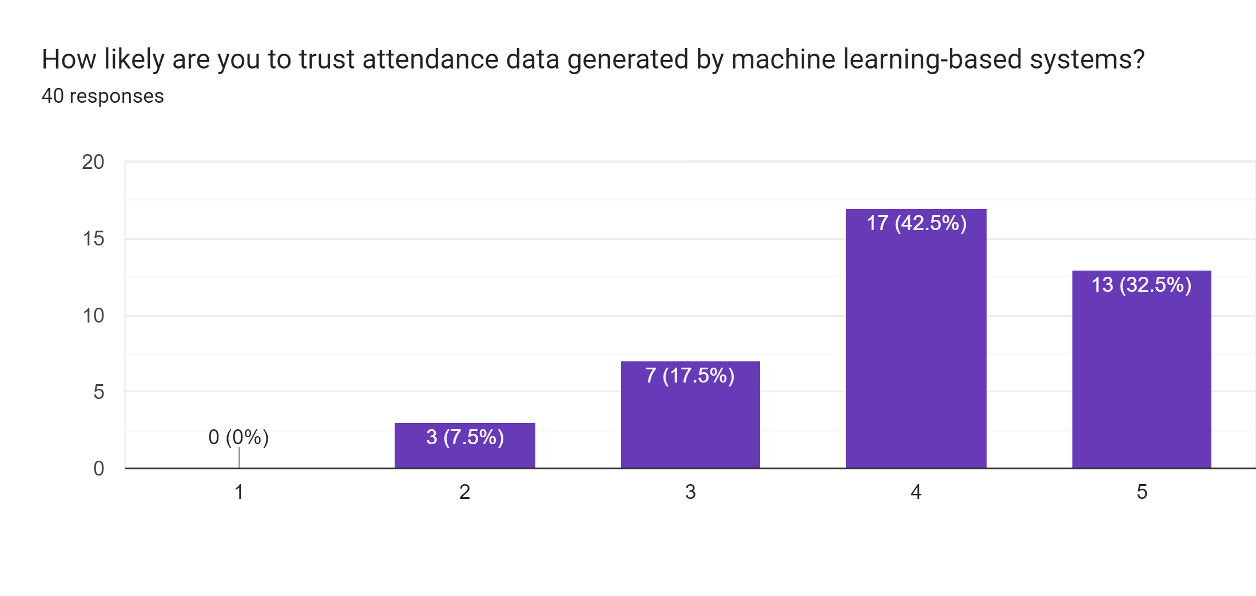
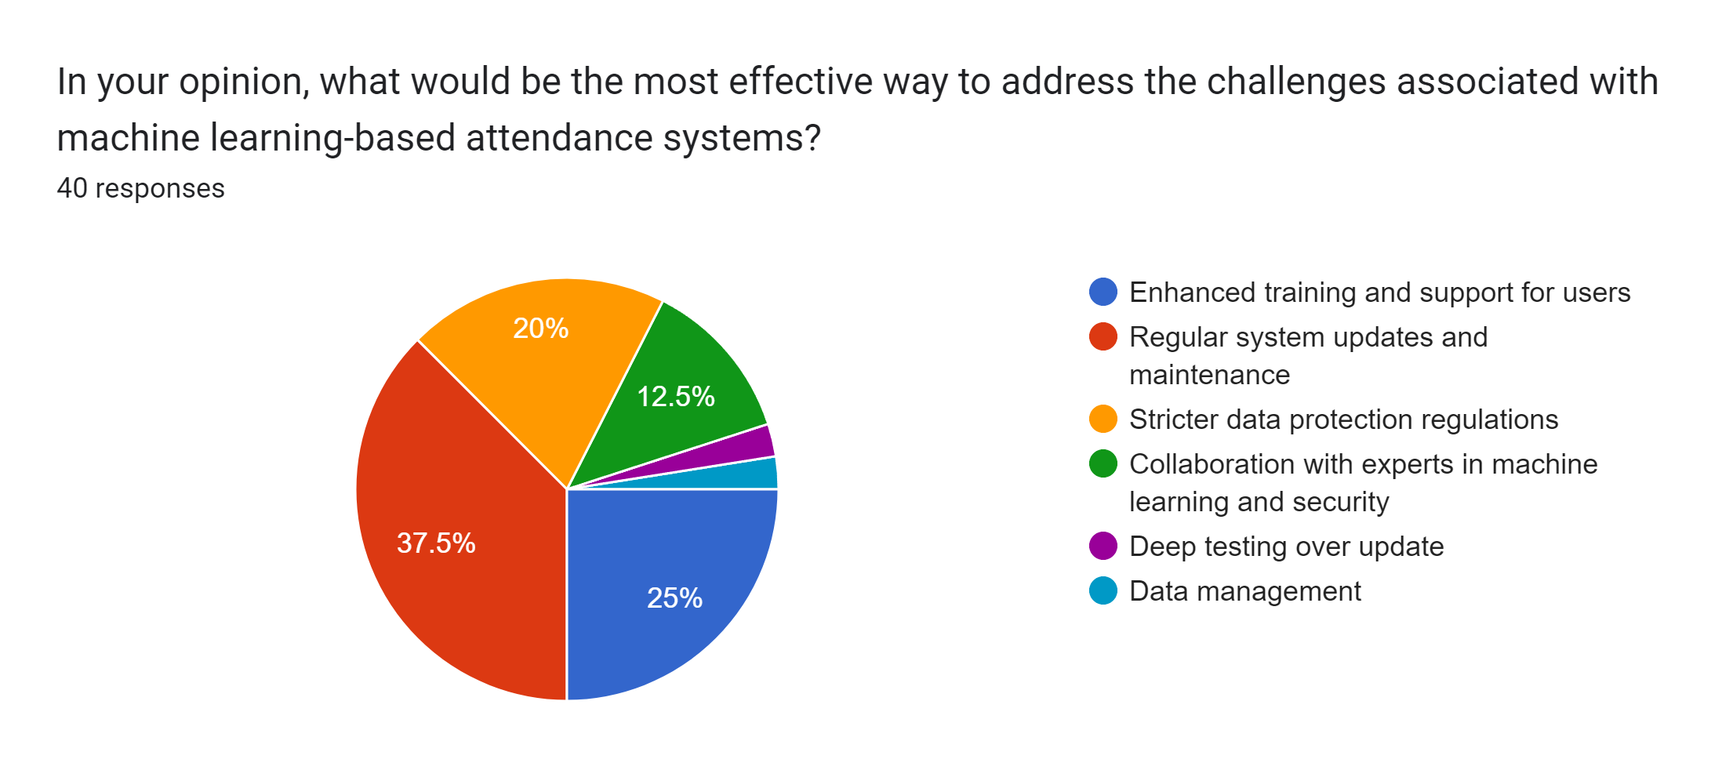
School of Computing Science and Engineering
2.2 Literature Survey
Project V B. Tech CSE Sem 7

Slide 6
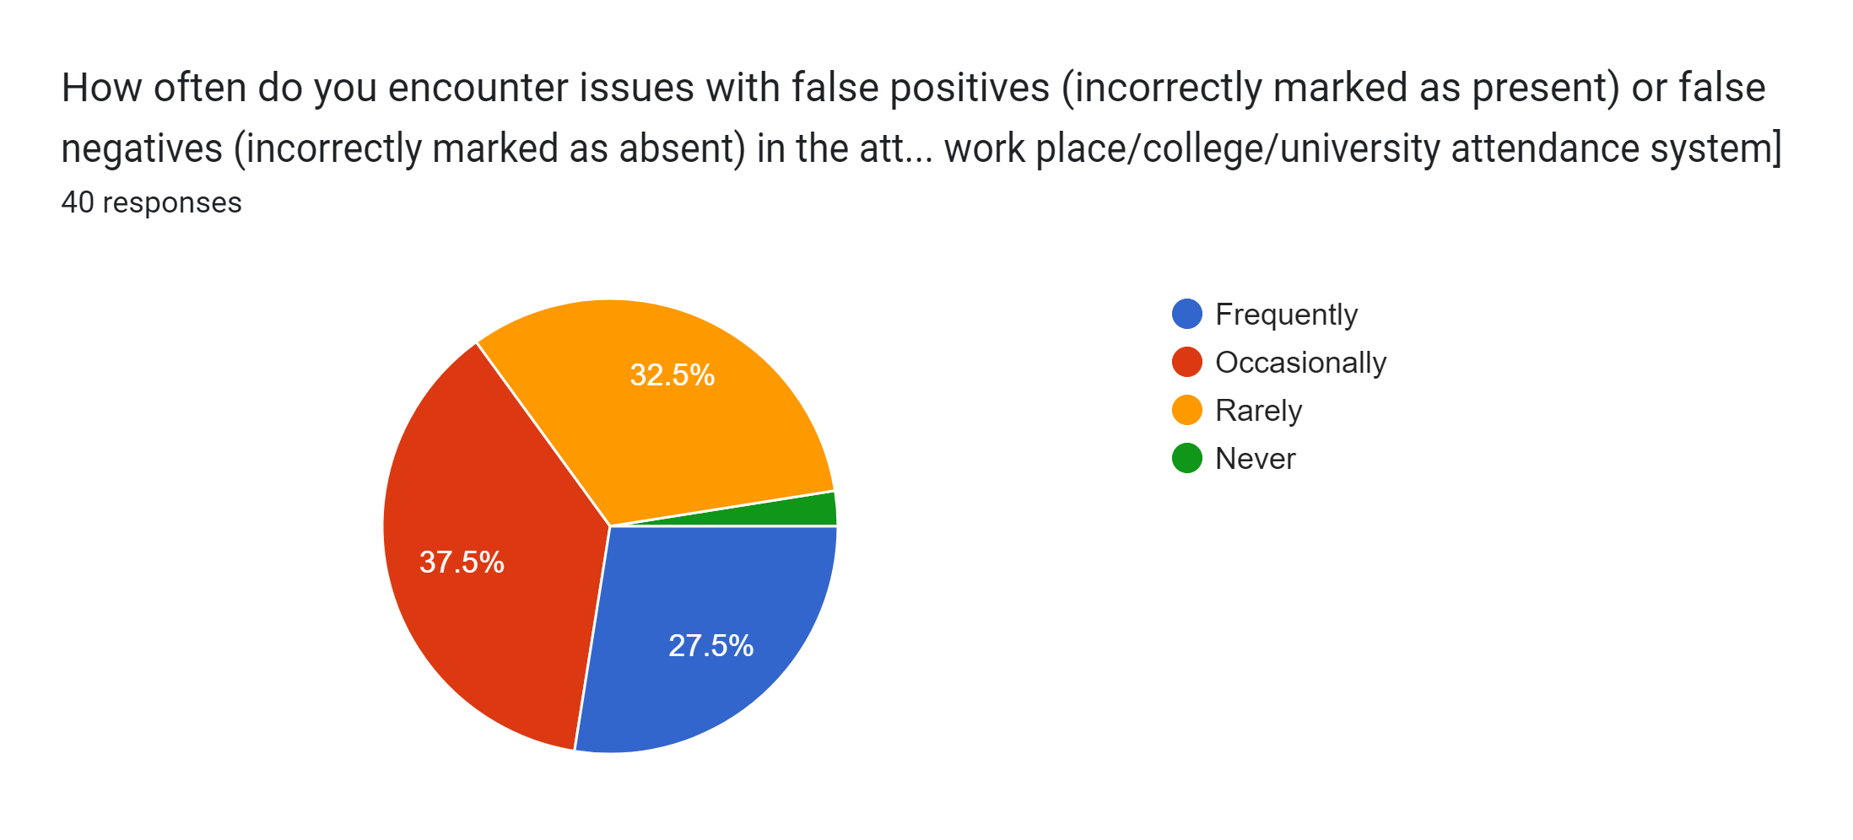
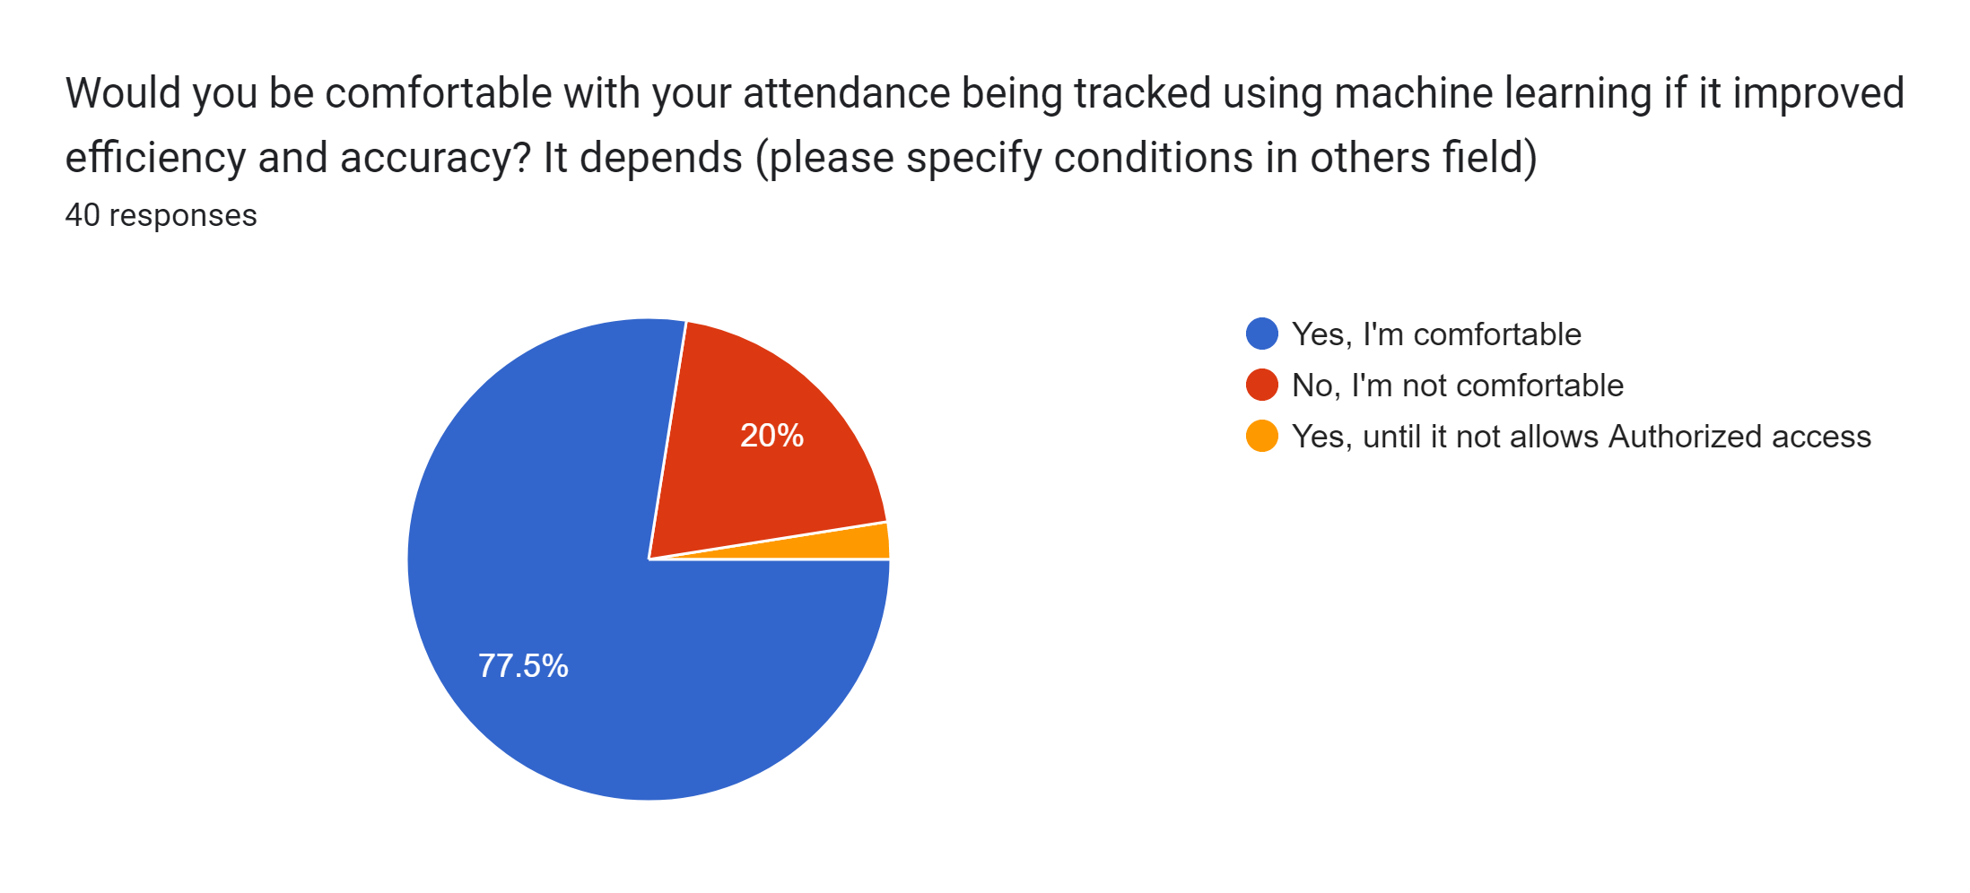
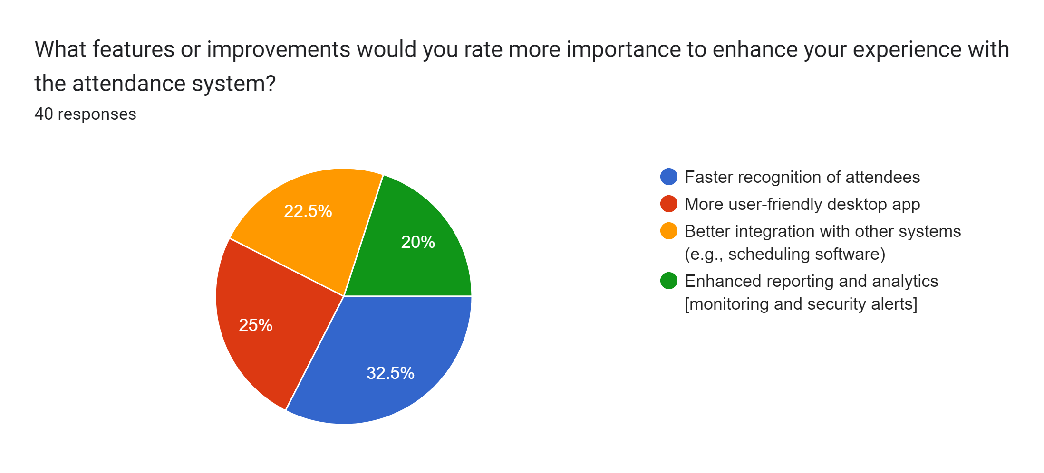
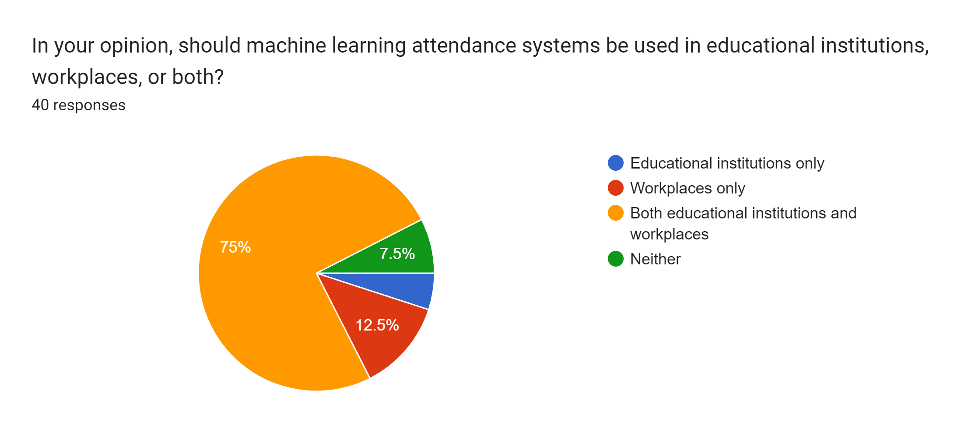
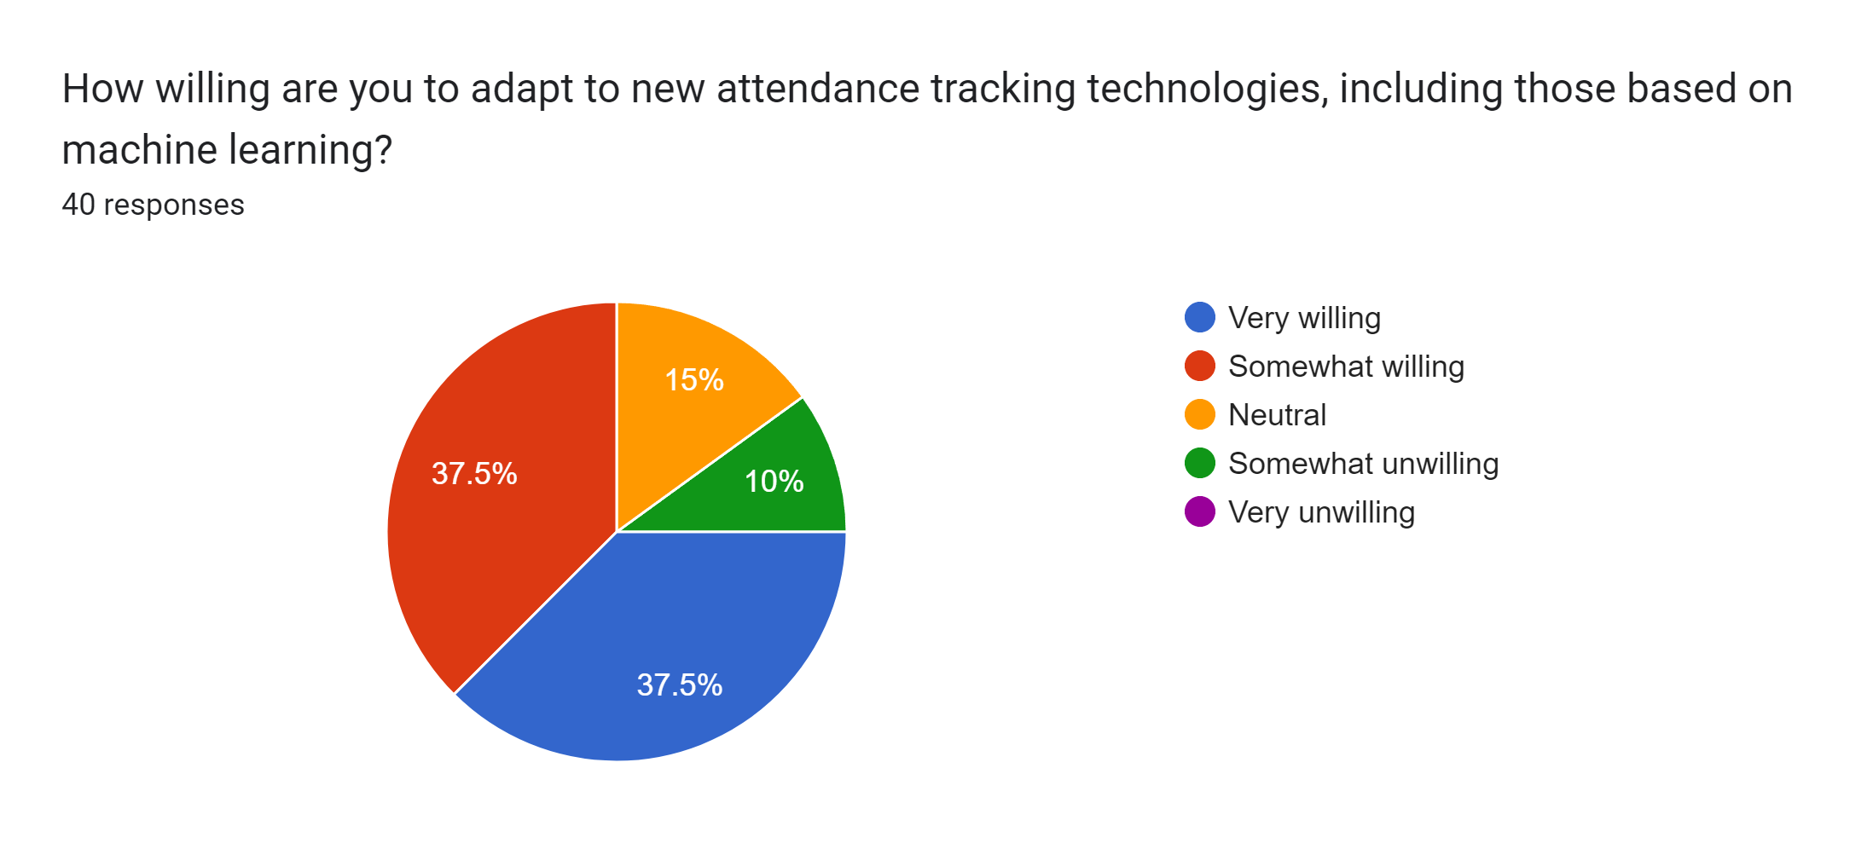
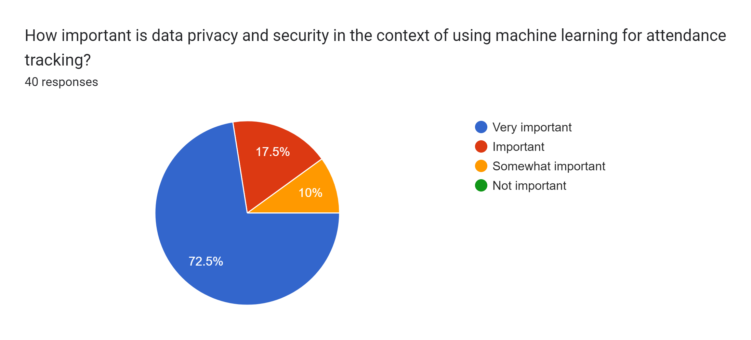
School of Computing Science and Engineering
2.2 Literature Survey
The Survey is done to the public to get proper access to the results and the results are out.
We concluded the following insights from Literature Survey
Accuracy over speed
Speed fater compared to traditional system
No issue during data transmission
Encryption and data backup
Monitoring and logging
Link:
https://github.com/Sah-Manish/
Project V B. Tech CSE Sem 7

Slide 7
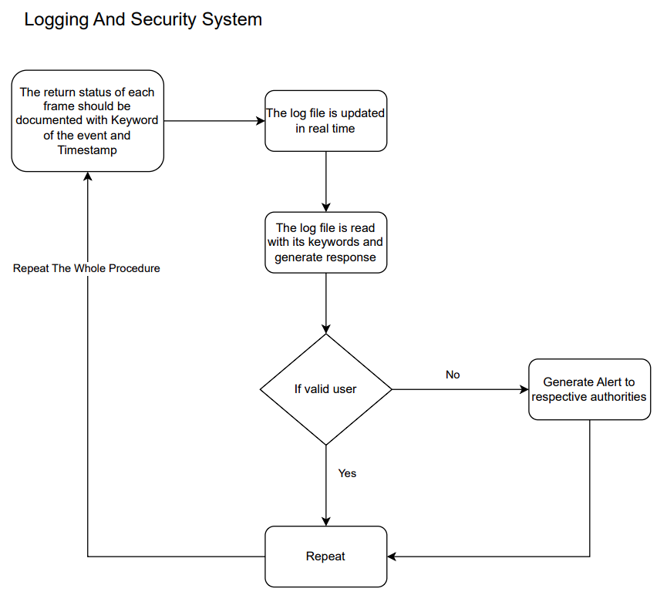
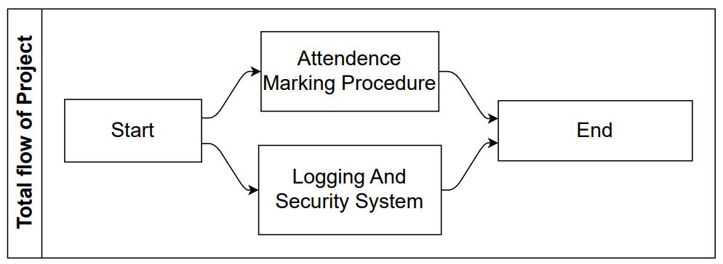
School of Computing Science and Engineering
3. System Model
Project revolves around two sub processes running simultaneously.
1. For marking attendance and monitoring event, and
2. Other Sub-Process is for logging and alert generation on the basis of current status of frame analyzed and alert keyword logged.
Fig 1: The Proposed System Architecture (a)
Project V B. Tech CSE Sem 7

Slide 8
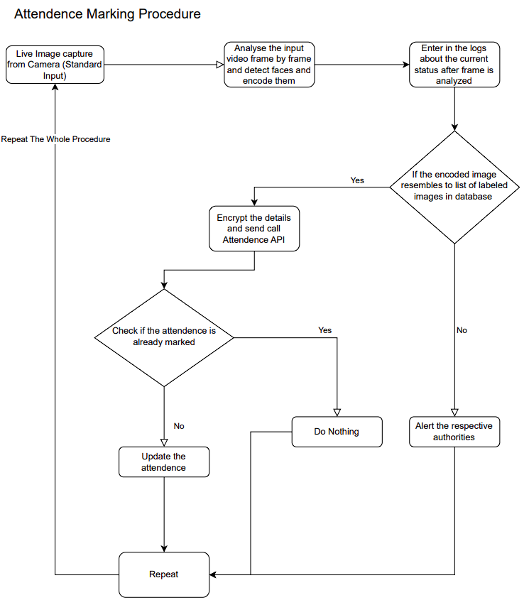
School of Computing Science and Engineering
3. System Model
This Sub-Process is very CPU intensive task and will generate all other sub-processes for our project to function.
The alert system run simultaneously to Attendance Marking Procedure Sub-Process, which logs the status in real time and other sub-process of Log Collection and Alert Generation generates status report of current frame and logs in system for further analysis by other program.
This other program reads live logging and looks for event keywords and generate alerts according to the keyword found.
Fig 1: The Proposed System Architecture (b)
Project V B. Tech CSE Sem 7

Slide 9
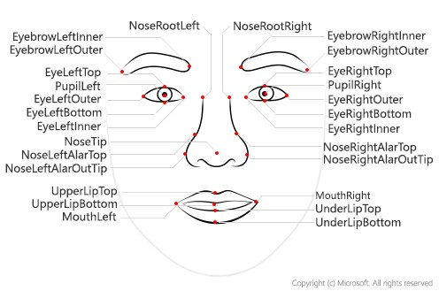
School of Computing Science and Engineering
4. Algorithm Used
Face Encoding Algorithm/Deep Learning for Face Recognition
Some of the widely used Deep Learning-based face recognition systems are:
DeepFace
DeepID series of systems
VGGFace
FaceNet
Face recognizers generally take face images and find the important points such as the corner of the mouth, an eyebrow, eyes, nose, lips, etc. The coordinates of these points are called facial feature points. There are 66 such points. In this way, a different technique for finding feature
points give different results.
Project V B. Tech CSE Sem 7

Slide 10
School of Computing Science and Engineering
5. Work Accomplished and Work Remaining
Work Accomplished:
Primary Data Collection for analysis
Literature Survey
Completed a basic python program where encoding and comparing of faces works
Logging and alert flow is done
Work Remaining:
API key and communication script
Encryption for communication data
DB API
Alert generation system
Project V B. Tech CSE Sem 7

Slide 11
School of Computing Science and Engineering
6. Challenges Faced
Challenges Faced
Although building facial recognition seems easy, it is not as easy in real-world images that are being taken without any constraints. There are several challenges that are faced by the Facial Recognitions System, as follows:
Illumination: It changes the face’s appearance drastically. It is observed that even slight changes in lighting conditions cause a significant impact on its results.
Pose: Facial Recognition systems are highly sensitive to the pose, Which may result in faulty recognition or no recognition if the database is only trained on frontal face view.
Facial Expressions: Different expressions of the same individual are another significant factor that needs to be taken into account. Modern Recognizers can easily deal with it, though.
Low Resolution: The recognizer must be trained on a good-resolution picture. Otherwise, the model will fail to extract features.
Aging: With increasing age, the human face features shape, lines, and texture changes which are yet another challenge.
Project V B. Tech CSE Sem 7

Slide 12
School of Computing Science and Engineering
7. Conclusion and Future Work
Conclusion:
Face recognition technology can be used to build practical systems for attendance tracking, security access control, and more.
The face recognition system can be built using Python programming language and popular libraries such as OpenCV and face recognition.
Once the face recognition model is built, it can be integrated with an attendance system using Python programming and database management tools.
Future work:
One-one Matching can be replaced by multiple faces detection at once.
Project V B. Tech CSE Sem 7

Slide 13
School of Computing Science and Engineering
8. References and Bibliography
https://papers.ssrn.com/sol3/papers.cfm?abstract_id=3851056
http://dx.doi.org/10.1109/ICNTE.2017.7947889
https://www.academia.edu/download/53620889/IRJET-V4I1286.pdf
Project V B. Tech CSE Sem 7

Slide 14
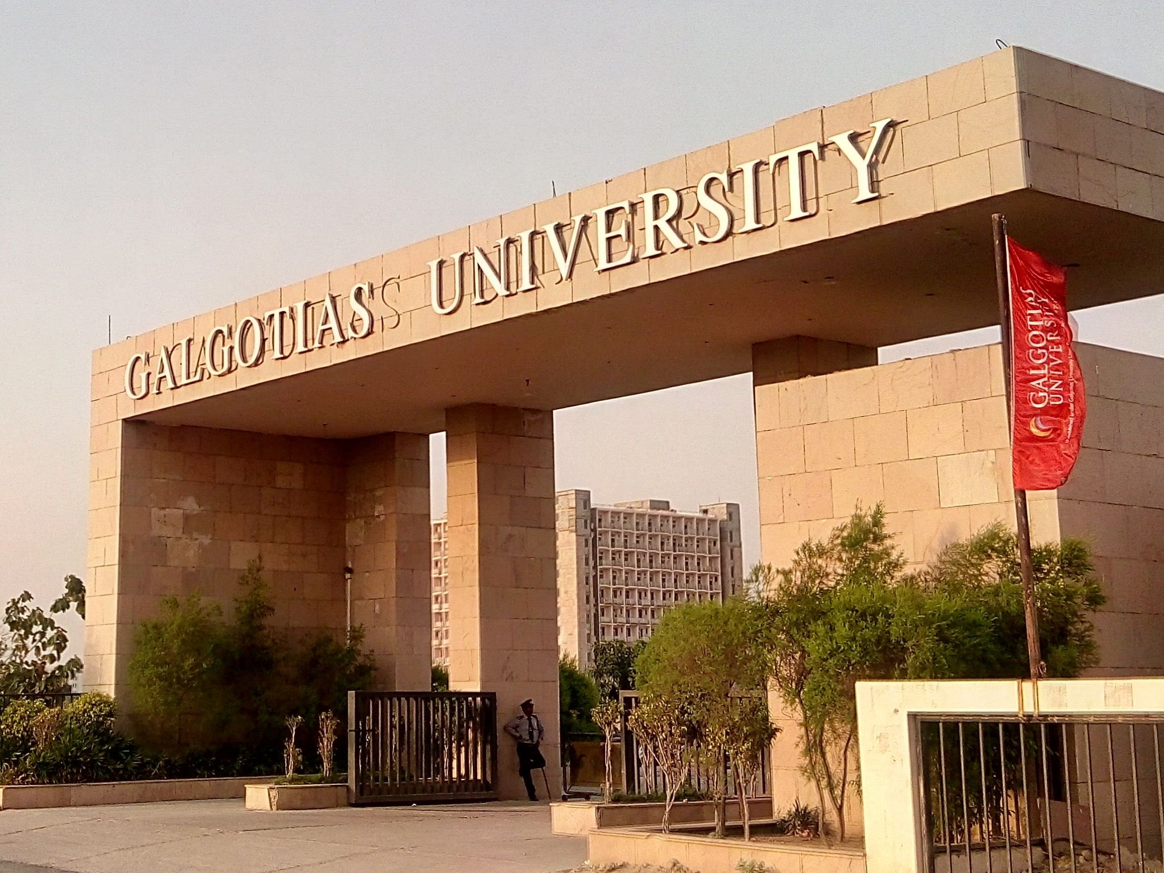
School of Computing Science and Engineering
------------------------
Thank You
Project V B. Tech CSE Sem 7

